Slide 1
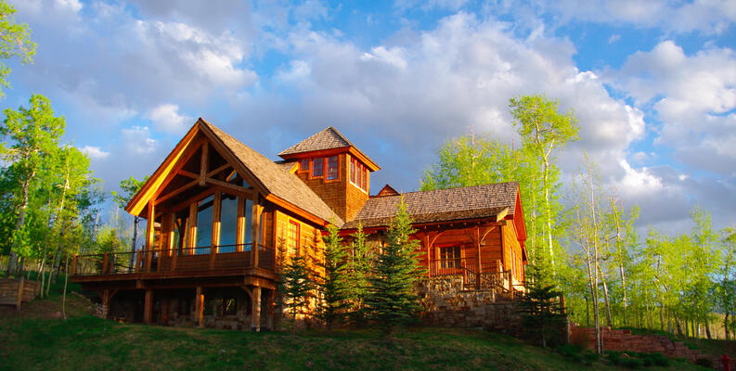

King Country Houses
TARGET --> Price: Our primary focus is to understand which features most significantly impact the house price. Additionally, we aim to explore properties valued at $650K and above for more detailed insights.
Dean Gani

Slide 2
Data overview
id: A unique identifier for a house.
date: The date on which the house was sold.
price: The sale price of the house (prediction target).
bedrooms: Number of bedrooms in the house.
bathrooms: Number of bathrooms in the house, per bedroom.
sqft_living: Square footage of the interior living space.
sqft_lot: Square footage of the land space.
floors: Number of floors (levels) in the house.
waterfront: Whether the house has a waterfront view.
view: Number of times the house has been viewed.
condition: The overall condition of the house.
grade: The overall grade given to the house, based on the King County grading system.
sqft_above: Square footage of the house apart from the basement.
sqft_basement: Square footage of the basement.
yr_built: The year the house was built.
yr_renovated: The year the house was renovated.
zipcode: ZIP code area.
lat: Latitude coordinate.
long: Longitude coordinate.
sqft_living15: The interior living space for the nearest 15 neighbors in 2015.
sqft_lot15: The land spaces for the nearest 15 neighbors in 2015.

Slide 3
Data Describe
Price: The average house price is approximately $540,088 with a standard deviation of $367,127. The prices range from $75,000 to $7,700,000.
Bedrooms: Most houses have about 3 bedrooms, with the number of bedrooms ranging from 0 to 33.
Bathrooms: On average, houses have around 2 bathrooms. The number of bathrooms ranges from 0 to 8.
Square Footage : The average living space is about 2,080 square feet, with a minimum of 290 and a maximum of 13,540 square feet.
Square Footage (Lot): The average lot size is approximately 15,107 square feet, but this value varies greatly (from 520 to 1,651,359 square feet).
Floors: Houses typically have between 1 and 3 floors, with an average of about 1.5 floors.
Waterfront: A very small proportion of houses have a waterfront view.
Condition and Grade: The average condition rating is about 3.4 (on a scale likely ranging from 1 to 5), and the average grade is about 7.7 (on a likely scale of 1 to 13).
Year Built and Renovated: Most houses were built around 1971, and many have not been renovated (indicated by the median and lower quartile values for the renovation year being 0).

Slide 4
Feature Engineering
year_sold,month_sold,day_sold “ Extracting components from date column for finer analysis
Season_sold: Categorize the sale into seasons for potential season trend analysis
House_age: valculate the age of the house at the time of sale
Years_since_renovation; Determine how long it has been since the house was last renovated
Price_per_sqft:calculate the price per square foot of living area
bathrooms: Round the number of bathrooms to the nearest inteher for simplicity
Bed_bath_rooms:Create an interanction term between bedrooms and bathrooms
Sqft_grade:Create a metric that combines the size of the living area with the quality grade of the house
Sqft_lot_grade: Create a metric that combines the lot size with the quality grade of the house.
zipcode: Ensure the zipcode column is treated as a categorical variable
Is_waterfron: create a binary variable indicating whether the house has a waterfront view
Is_renovated:Create a binary variable indicating whether the house has been renovated

Slide 5
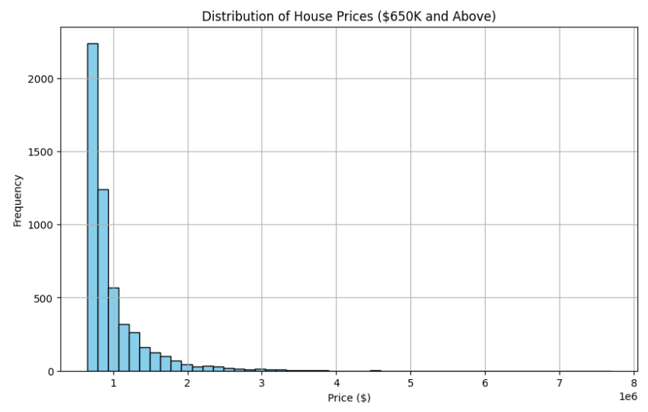
Distribution
The histogram above illustrates the distribution of house prices for properties valued at $650K and above. Here are a few observations:
The majority of the houses are priced between $650K and $1.5M.
There are fewer houses as the price increases beyond $1.5M, with a notable decline in frequency.
The distribution shows a long tail, indicating the presence of some very high-priced houses in the dataset.

Slide 6
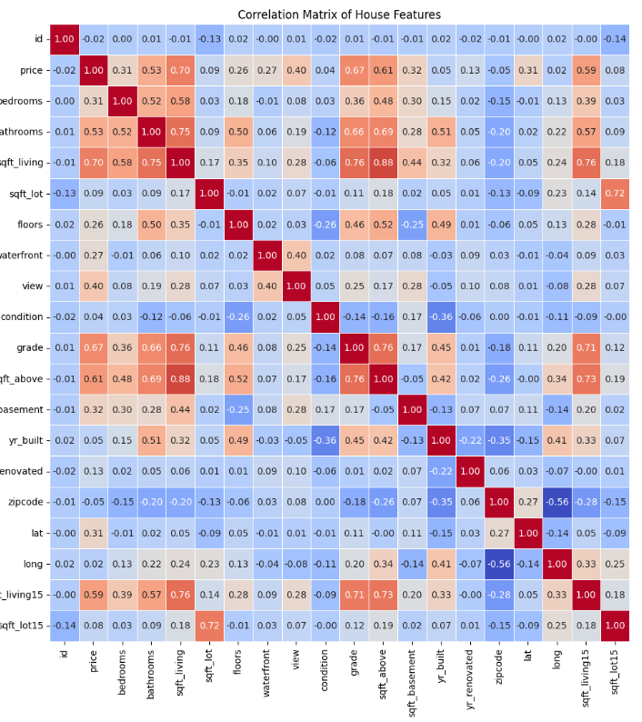
Correlation Matrix
Key observations:
The strong positive correlations between price and features like square footage (living and above), grade, and bathrooms are evident.
Some features, such as latitude (lat) and waterfront, show moderate positive correlations with price.
Features like id and zipcode have very weak or negligible correlations with price, indicating they don't significantly impact house prices.

Slide 7
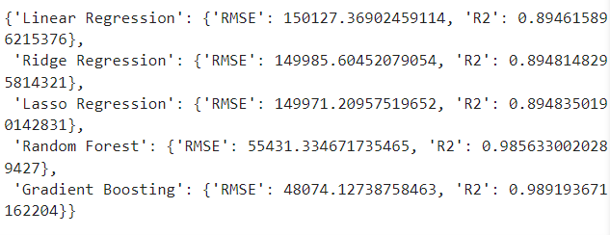
Model to train
Model : Linear Regression , Ridge Regression, Lasso Regression, Random Forest and Gradinet Boosting

Slide 8
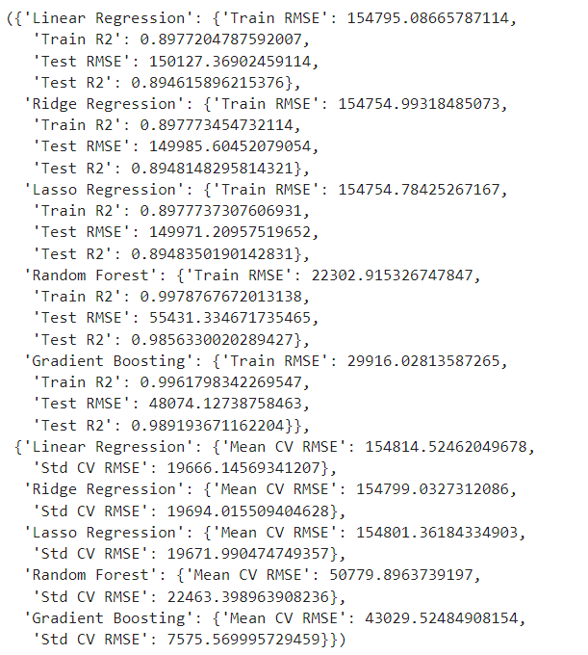
Overfiting?
Train-Test Metrics: Look at the Train RMSE and Test RMSE for each model. If the Train RMSE is significantly lower than the Test RMSE, the model might be overfitting.
Cross-Validation Results: Cross-validation provides a more robust evaluation of the model's performance. The Mean CV RMSE should be close to the Test RMSE. A high Std CV RMSE indicates high variability in the model's performance across different folds, which might suggest overfitting.

Slide 9
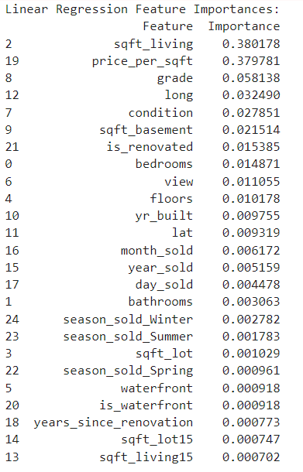
Linear Regression
High Importance Features:
sqft_living (38.02%):Explanation: This feature represents the square footage of the living space in the house. It is the most important feature, indicating that the size of the living area has a significant impact on house prices.
price_per_sqft (37.98%):Explanation: This feature represents the price per square foot. Its high importance suggests that the price efficiency of the space is a critical factor in determining overall house prices.
grade (5.81%):
Explanation: The grade is a measure of the overall quality of the house, which includes the quality of construction and design. It moderately impacts house prices, reflecting that better-quality houses tend to be more expensive.
long (3.25%):
Explanation: Longitude of the house's location. This feature can capture regional differences in pricing, indicating that geographic location (longitude) plays a role in house valuation.
condition (2.79%):
Explanation: This feature represents the condition of the house (e.g., good, fair). Houses in better condition are likely to have higher prices.

Slide 10
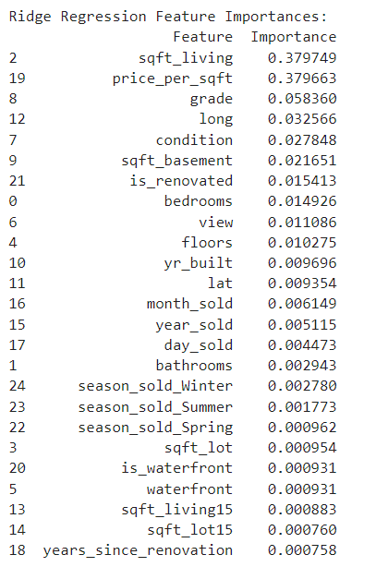
Ridge Regression
sqft_living (37.97%):
Explanation: This feature represents the square footage of the living space in the house. It is the most important feature, indicating that the size of the living area has a significant impact on house prices.
price_per_sqft (37.97%):
Explanation: This feature represents the price per square foot. Its high importance suggests that the price efficiency of the space is a critical factor in determining overall house prices.
grade (5.84%):
Explanation: The grade is a measure of the overall quality of the house, which includes the quality of construction and design. It moderately impacts house prices, reflecting that better-quality houses tend to be more expensive.
long (3.26%):
Explanation: Longitude of the house's location. This feature can capture regional differences in pricing, indicating that geographic location (longitude) plays a role in house valuation.
condition (2.78%):
Explanation: This feature represents the condition of the house (e.g., good, fair). Houses in better condition are likely to have higher prices.

Slide 11
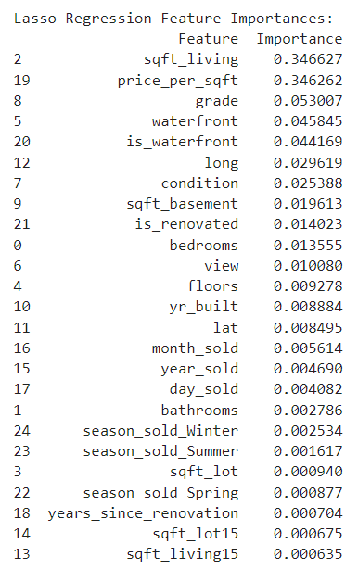
Lasso Regression
sqft_living (34.66%):
Explanation: This feature represents the square footage of the living space in the house. It is the most important feature, indicating that the size of the living area has a significant impact on house prices.
price_per_sqft (34.63%):
Explanation: This feature represents the price per square foot. Its high importance suggests that the price efficiency of the space is a critical factor in determining overall house prices.
grade (5.30%):
Explanation: The grade is a measure of the overall quality of the house, which includes the quality of construction and design. It moderately impacts house prices, reflecting that better-quality houses tend to be more expensive.
waterfront (4.58%):
Explanation: Indicator of whether the house is on the waterfront. This feature significantly impacts house prices, suggesting that waterfront properties are highly valued.

Slide 12

Thank You
Questions ?

